Slide 1
TypeScript
Modules
Lecture 4
By James(Jin) Wang
09/15/2019

Slide 2
Outline
What’s a Module?
Internal Modules
Importing External Modules and Managing Large Applications
Recap

Slide 3
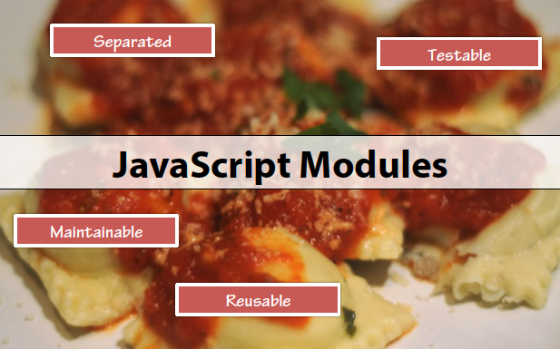
What’s a Module

Slide 4
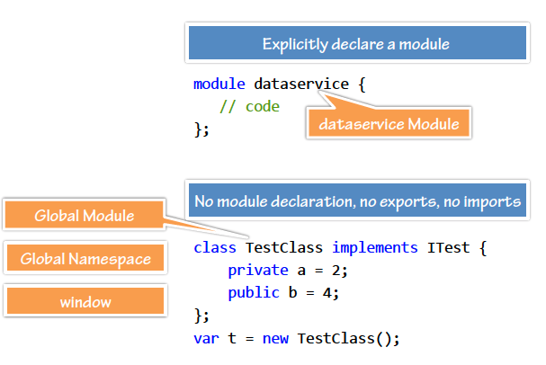
What’s a Module
  You May Be a Module if:

Slide 5
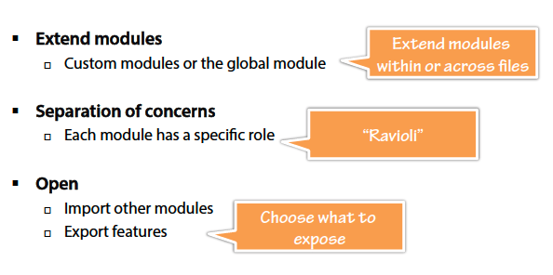
What’s a Module
  Module Flexibility:
  Demo: Global Module

Slide 6
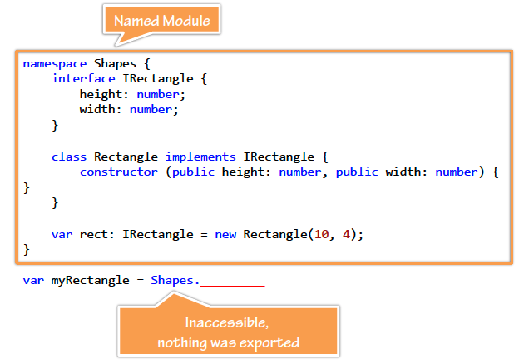
Internal Modules
  Internal – Named Module:

Slide 7
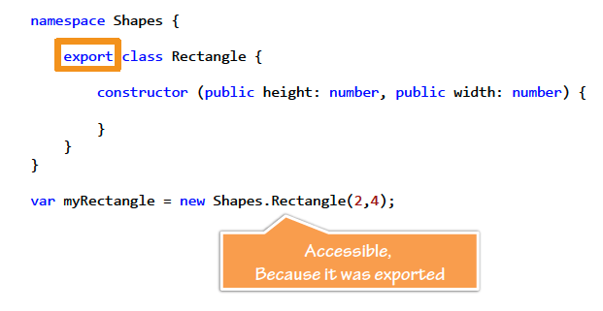
Internal Modules
  Exporting Internal Modules:

Slide 8
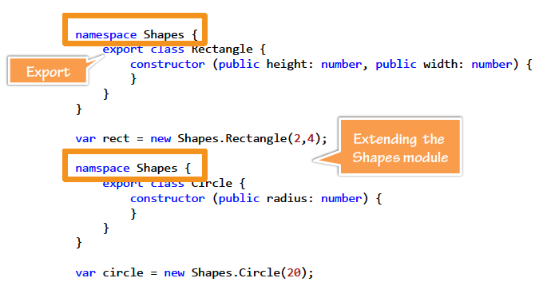
Internal Modules
  Extending Internal Modules:

Slide 9
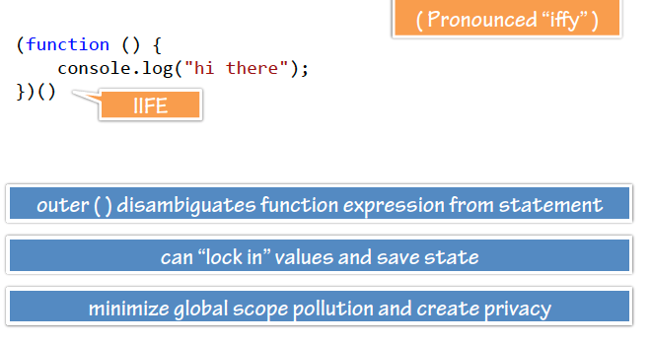
Internal Modules
  Immediately-Invoked Function Expression:

Slide 10
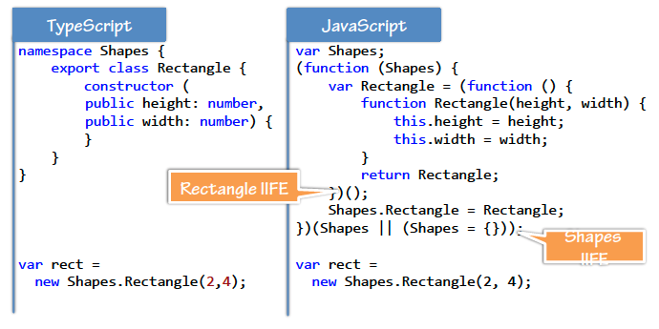
Internal Modules
  Emitting IIFE:
  Demo: Internal Module
  Demo: Extending Internal Module

Slide 11
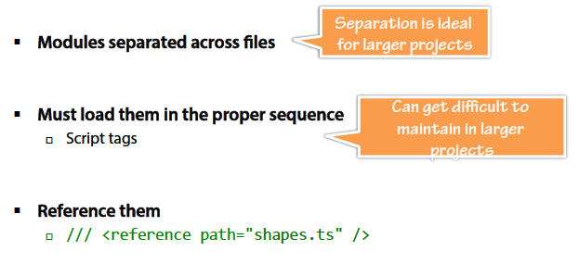
Referencing Internal Modules
  Separating Internal Modules:

Slide 12
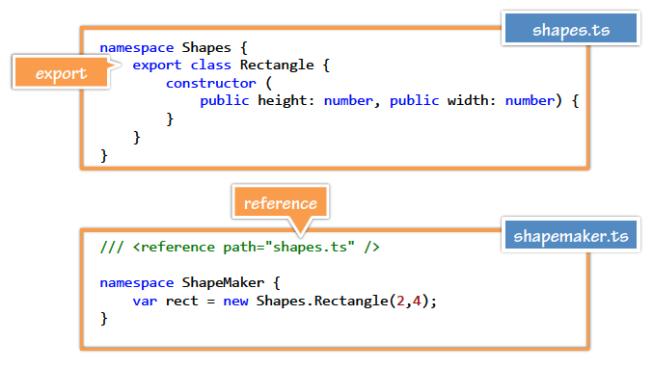
Referencing Internal Modules
  Separation:

Slide 13
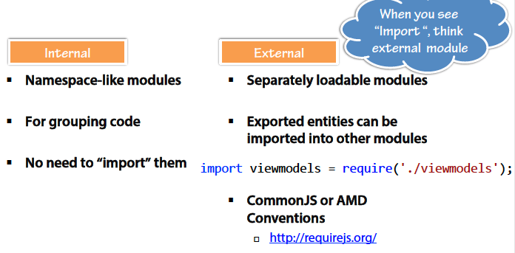
Importing External Modules and Managing Large Applications
  Internal and External Modules:

Slide 14
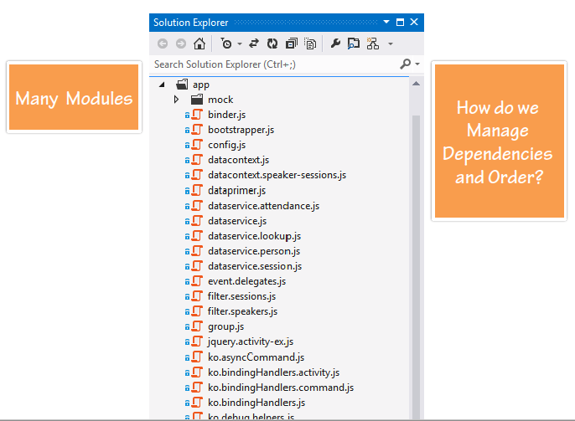
Importing External Modules and Managing Large Applications

Slide 15
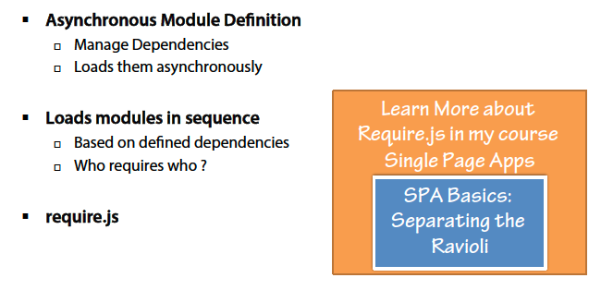
Importing External Modules and Managing Large Applications
  AMD:

Slide 16
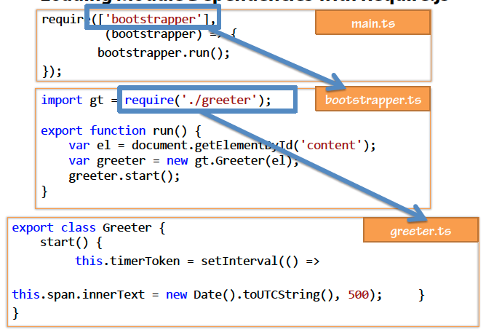
Importing External Modules and Managing Large Applications
  Loading Module Dependencies with Require.js:

Slide 17
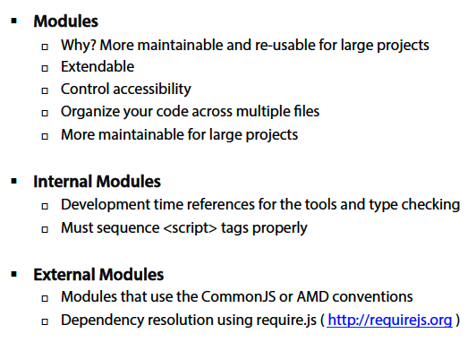
Summary

